Slide 1

Effect of Covid-19 on New York City Transportation (March 2020 – June 2020)
By: Michael Reichard, Yeonjae Riyoon, Joshua Sohan, Anumala Thapa

Slide 2
Table of Contents
Ridership
Taxi & For-Hire Vehicles
Citibike
Subway
Questions

Slide 3

Questions
Did Citibike usage increase/decrease due to the several phases in NYC?
What was the transportation usage between March 2019 to June 2019?
What was the transportation usage between March 2020 to June 2020?
What means of transportation was used the most and the least between March 2019 to June 2019?
What means of transportation was used the most and the least between March 2020 to June 2020?
Which borough had the most and the least usage of transportation during March 2020 to June 2020?

Slide 4
Taxi & For-Hire Vehicles Usage

Slide 5
Taxi and For-hire Vehicles:
Data sources:
https://github.com/nychealth/coronavirus-data
https://www1.nyc.gov/site/tlc/about/tlc-trip-record-data.page
Focal Point:
Case count from coronavirus data
Pick-up datetime from trip record data
Consideration:
Yellow Taxi, Green Taxi and For-hire Vehicles(i.e community based liveries, black cars and luxury limousines)

Slide 6
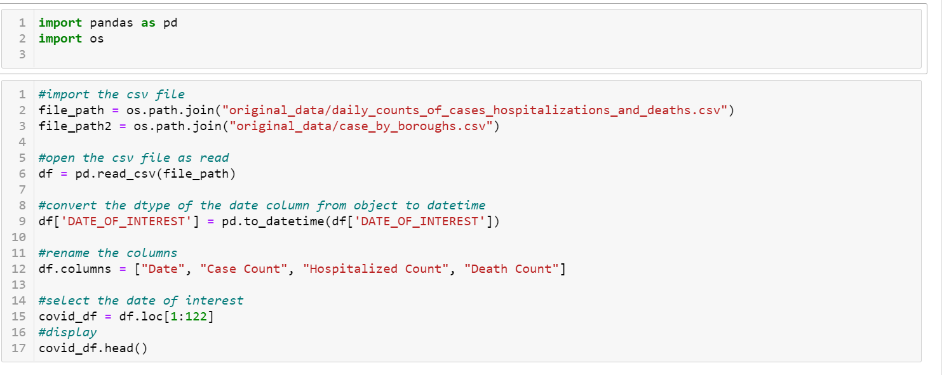
Covid-19 Data

Slide 7
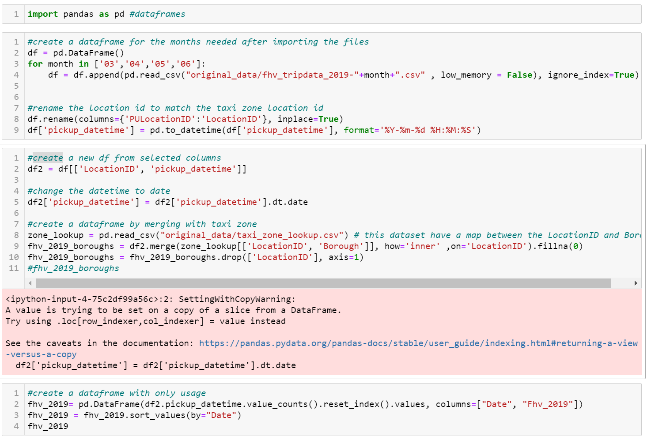
Taxi & FHV: Cleaning the Data

Slide 8
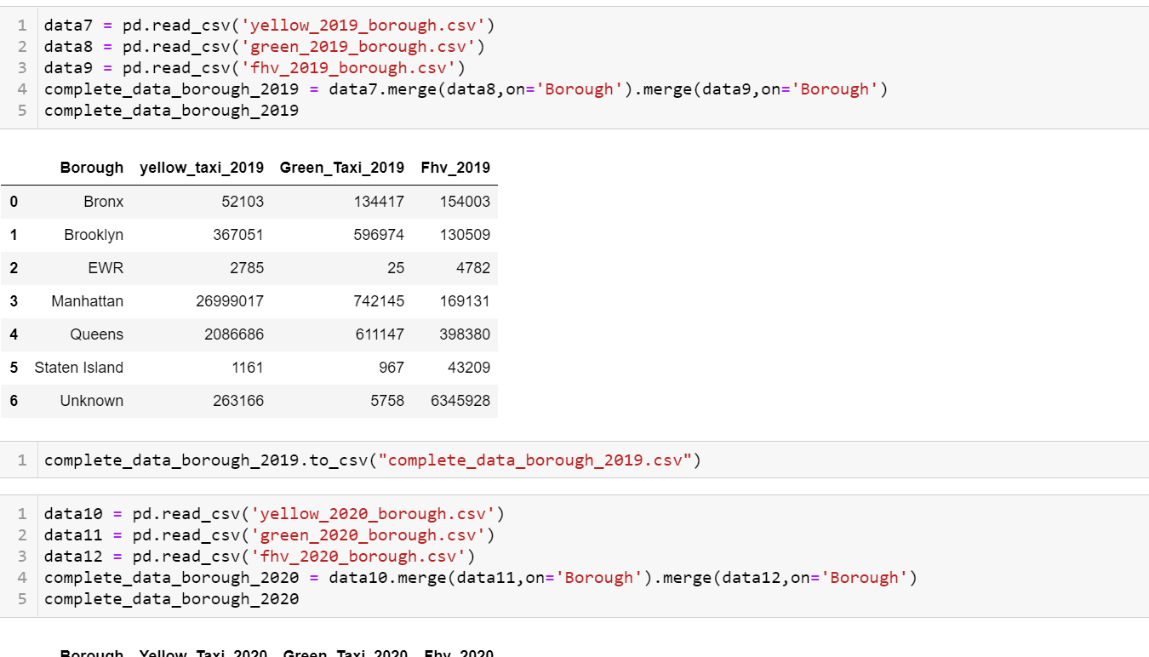
Taxi & FHV: Cleaning the Data

Slide 9
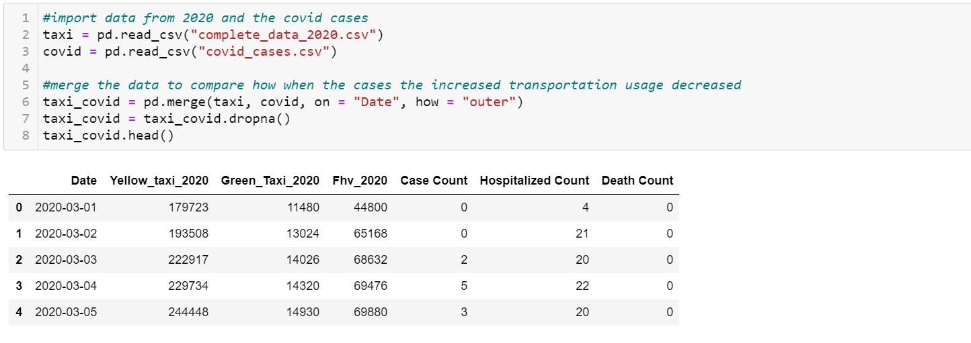
Taxi & FHV: Cleaning the Data

Slide 10
Taxi vs Covid:
March 20:
Lockdown
Case count: 4007
June 8:
Phase 1
Case count: 451
Usage went down during lockdown and started picking up slowly
Yellow cabs took the hit the most

Slide 11
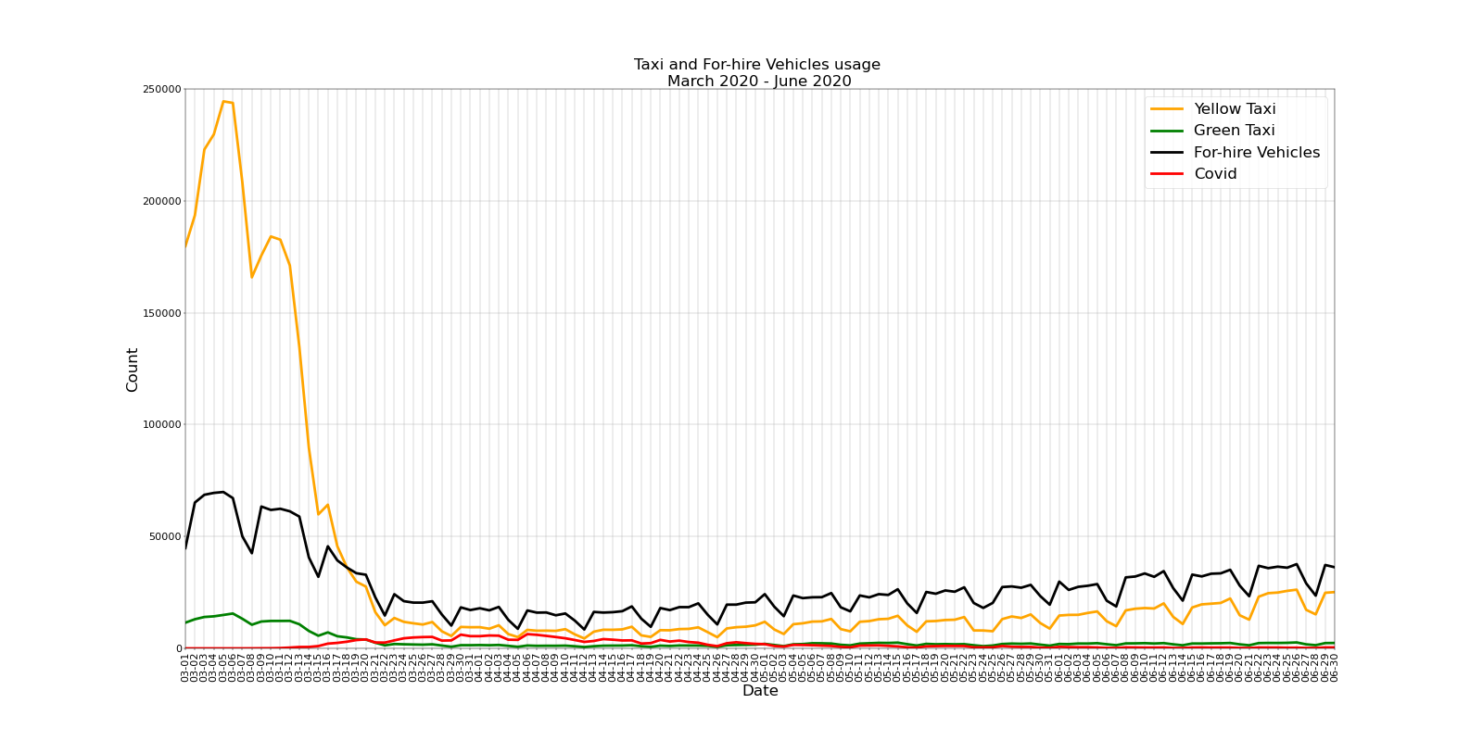

Slide 12
2019 vs 2020:
Compared to last year of March to June:
Yellow cabs decreased by almost 86%
Green cabs decreased by 81%
For-hire vehicles by 54%
(fyi: only 1 in 4 yellow cabs are in operation)

Slide 13
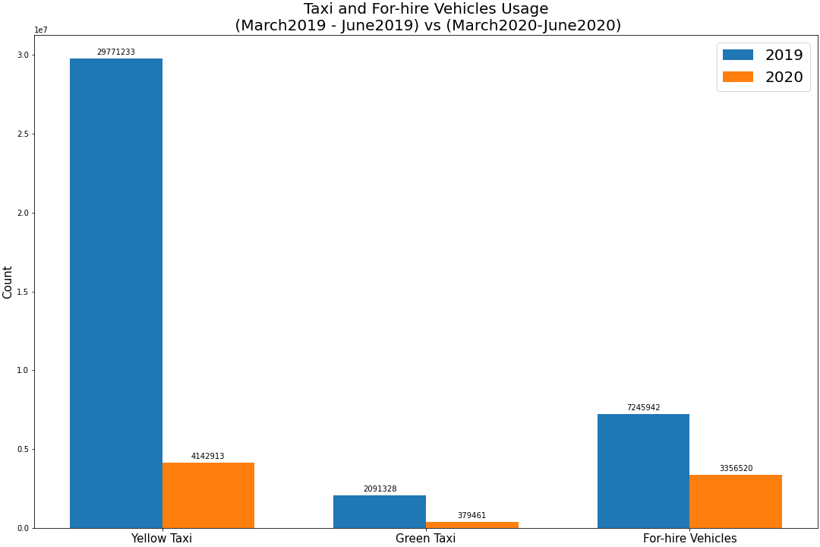

Slide 14
Usage by Borough:
Focal Point : Yellow Taxi
Used the most in Manhattan
86% decrease in use in Manhattan
88% decrease in use in Queens
(fyi: highest case counts in Queens)

Slide 15
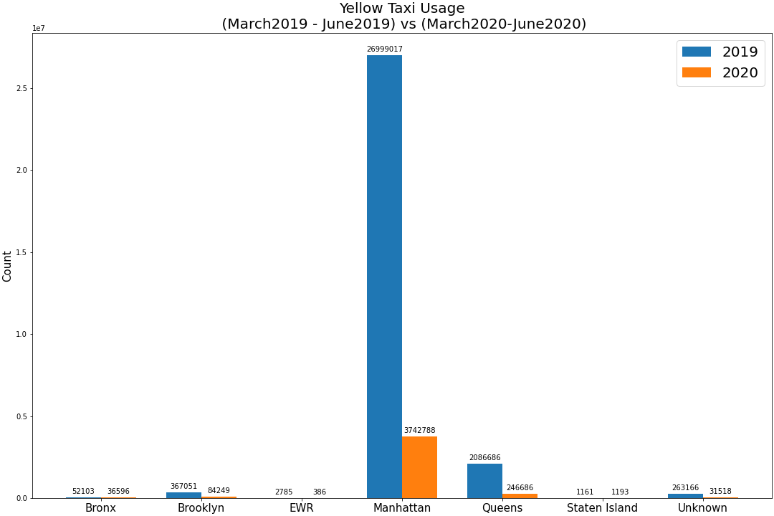

Slide 16
Citibike Usage

Slide 17
Citibike Data
Data sources:
https://s3.amazonaws.com/tripdata/index.html
Focal Point:
Number of trips by month
(March – June 2019) vs (March – June 2020)
How did Covid 19 affect the Citi Bike ridership (March 2020 – June 2020

Slide 18
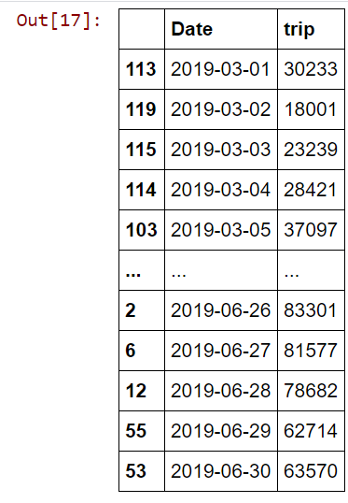
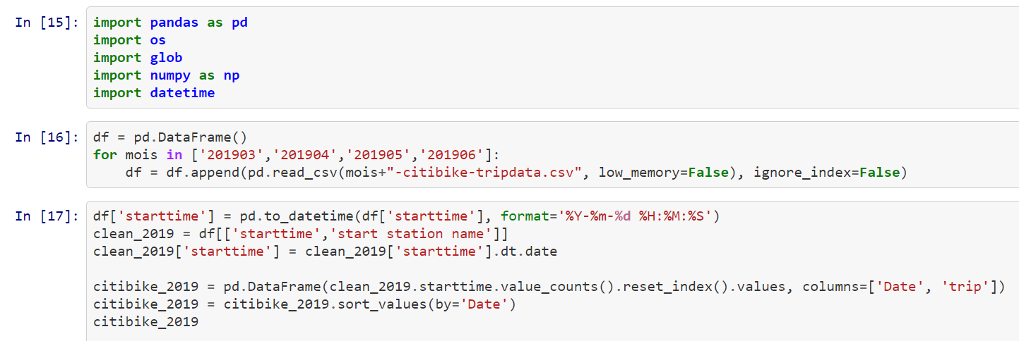
Citibike Usage <March – June 2019>

Slide 19
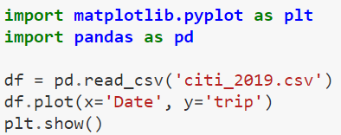
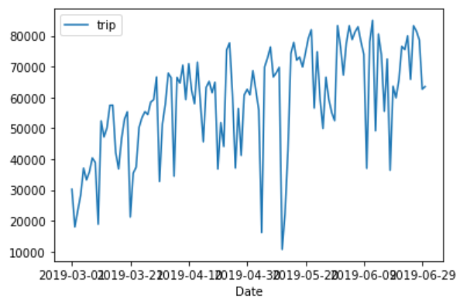
Citibike Usage Graph <March – June 2019>

Slide 20

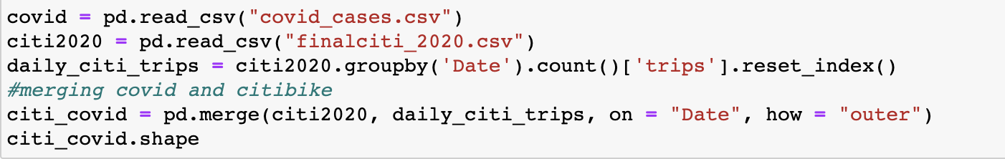
Citibike Usage <March – June 2020>: Cleaning

Slide 21
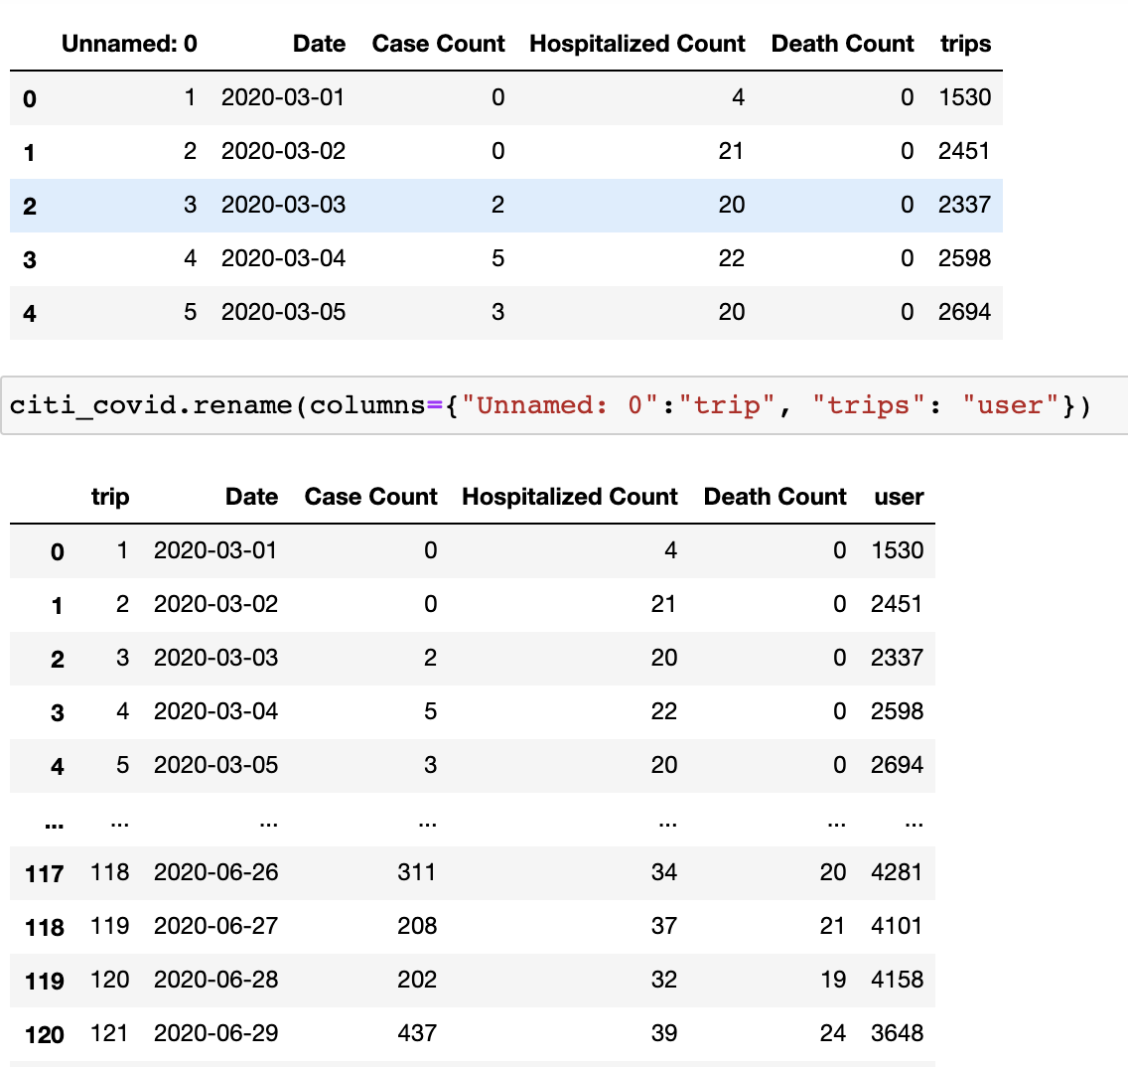
Citibike Usage <March – June 2020>: Cleaning

Slide 22
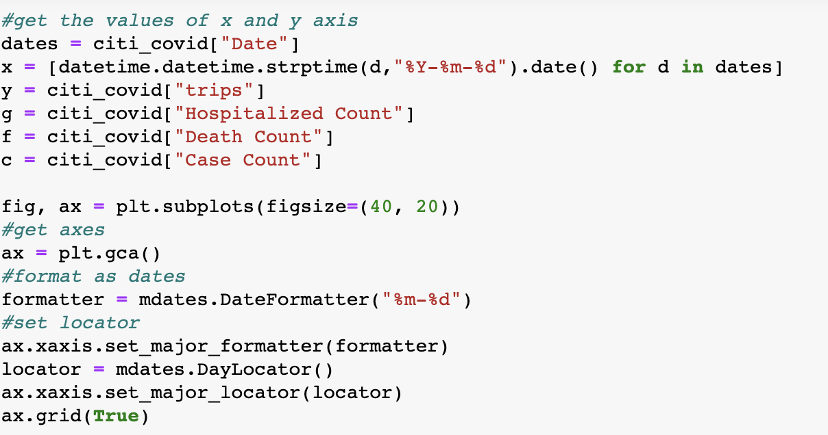
Citibike Usage <March – June 2020>: Cleaning

Slide 23
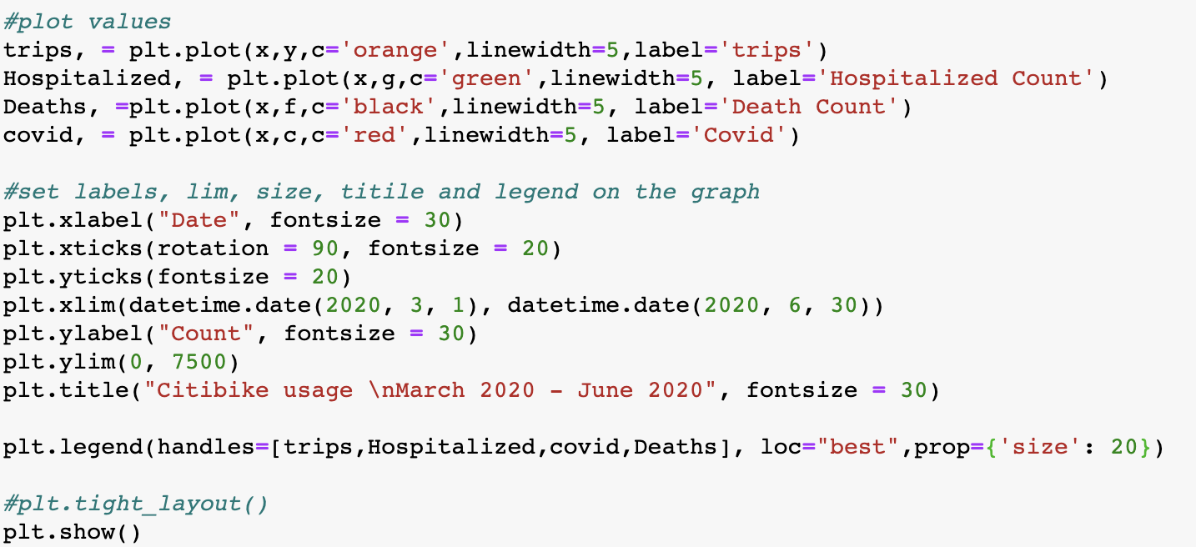
Citibike Usage <March – June 2020>: Cleaning

Slide 24
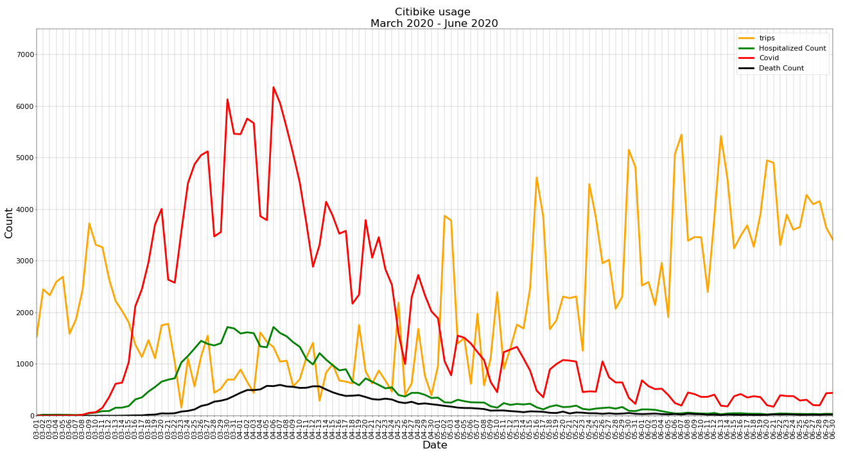

Slide 25
Subway Usage

Slide 26
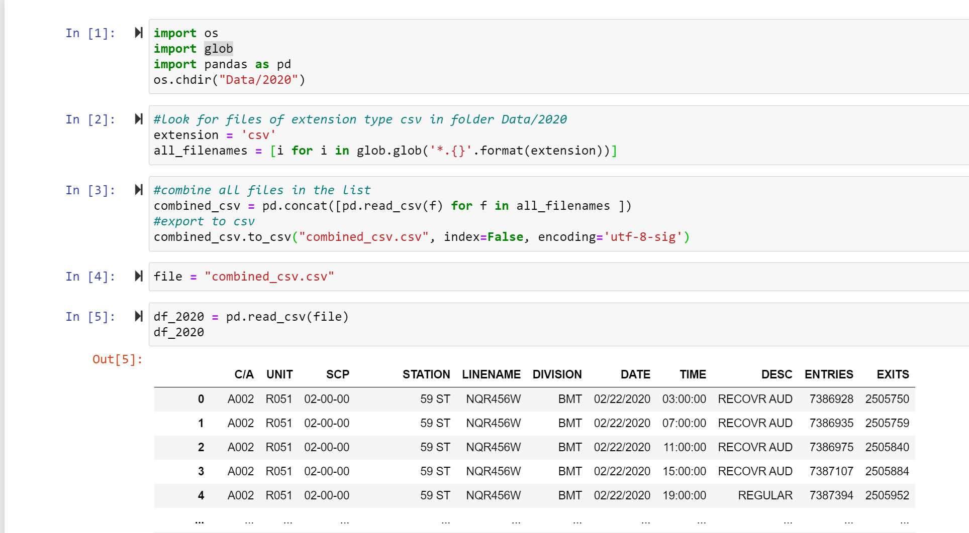
Subway Usage: Cleaning

Slide 27
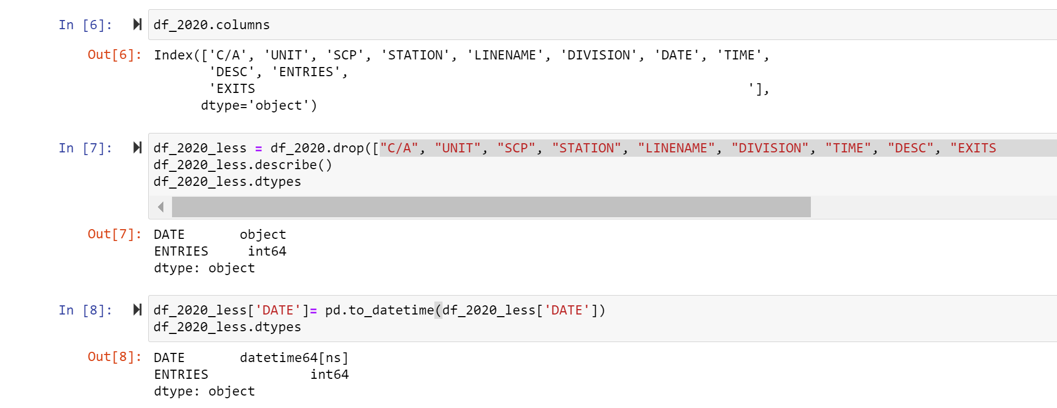
Subway Usage: Cleaning

Slide 28
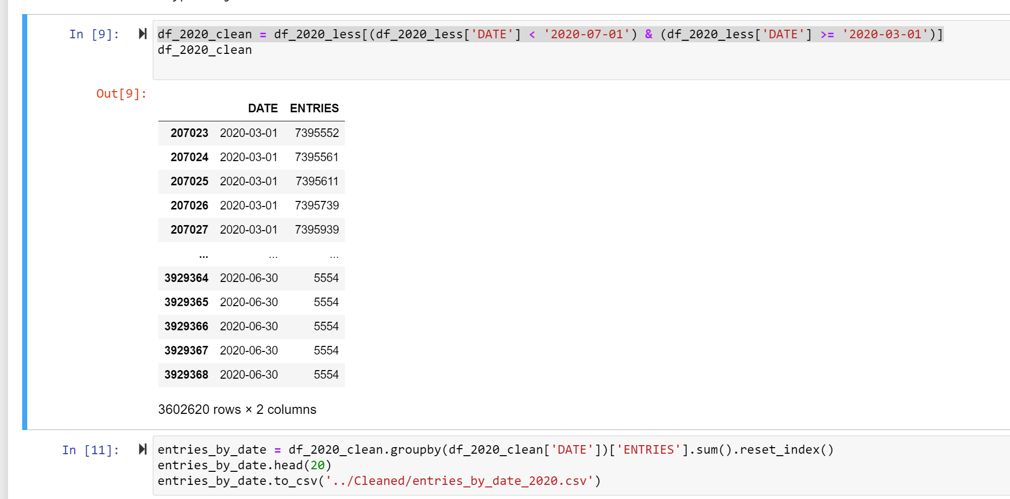
Subway Usage: Cleaning

